Slide 1
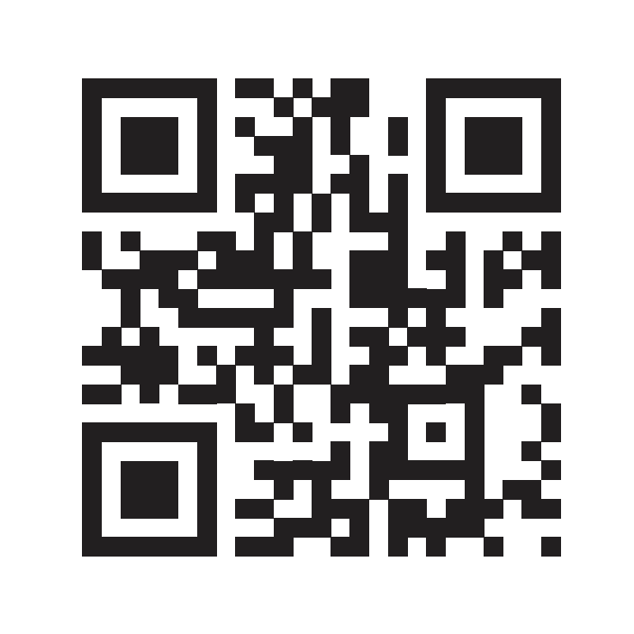
Get yourself #voteready
Using your phone: Check your voter registration status
Decide where you will vote:
In person at school or home;
or absentee ballot
Register or update your registration
Research candidates:
Sample ballots available 30 days before election
Find information about candidates: Vote411.org, Ballotpedia
Request absentee ballot or find your polling location
Consider working at the polls during the election
For more information go to Votingissocialwork.org
s.uconn.edu/VoteSW

