Slide 1
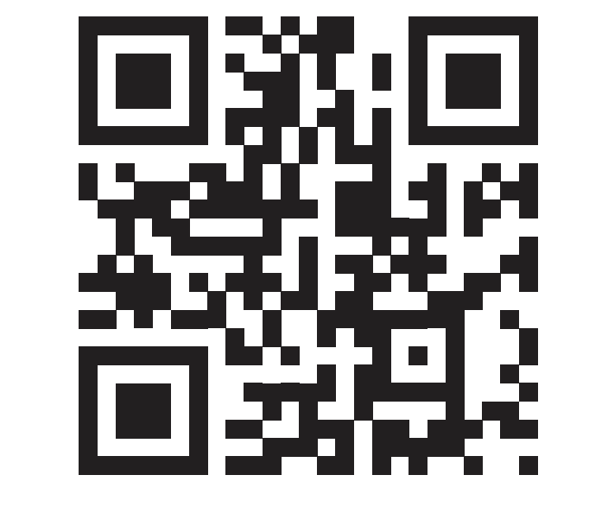
Get yourself #voteready
1. Register to Vote. Use this QR code or web link to:
Check your voter registration status (less than 30 seconds)
Register or update your registration (less than 2 mins)
Find the voting rules and deadlines for your state
2. Decide when and where you will voteot).
Request an Absentee Ballot Application
Vote in person
3. Be an informed voter! Learn more about the candidates and issues:
The League of Women Voters National Guide: Vote411.org
Sign up for reminders to vote and your polling location before every election
S.UConn.edu/VoteSW
Works in all 50 states!

